Slide 1
Profiling Applications on an ARM Instrumented Server via RPT
Yoonki Song
Last Updated: Sep. 22, 2009

Slide 2
Prerequisites
Part I

Slide 3
Prerequisites
Server Side
WebSphere Application Server (WSAS) v6.1 Setup
Refer to “PerfTest – Setup (WSAS).pptx”
Rational Performance Tester (RPT) Agent v8.0 Setup
Refer to “PerfTest –Setup (RPT agent).ppt”
Client Side
Rational Performance Tester (RPT) v8.0 Setup
Refer to “PerfTest – Setup (RPT).pptx”

Slide 4

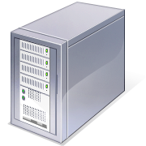

Environment for ARM Instrumentation
Client:
My desktop (Dynamic IP)
Java v1.5 (or lower)
Rational Performance Tester v8.0
with Agent (Data Collection Infrastructure v7.0)
Server:
eb2-2241-grd03.csc.ncsu.edu (152.14.90.72)
Java v1.5 (or lower)
WebSphere Application Server v6.1
Rational Performance Tester Agent
(Data Collection Infrastructure v7.0)

Slide 5

Sequence for Collecting Trace data with Instrumentation (RPT-ARM)
Client
Server
#/root/perftest/startARM.sh
Start Rational Agent Controller (RAC)
Note: RAC should be running prior to DCI
Start Data Collection Infrastructure (DCI)
Note: DCI should be running prior to WSAS
Start WebSphere Application Server (WSAS)
4. Start DCI
5. Start RPTv8.0
6. Start Recording and Launching Test/Schedule via RPT
Trace data (A)
Note: This task should be always done whenever the server/client reboots.
Notes:
3451 <- x
4513 <-

Slide 6
Instrumentation

Slide 7
Using the Java Profiler with JVM 1.4 (or lower)
Go to <profile root>/config/cells/<nodename>Cell/nodes/<nodename>/servers/server1
Edit the jvmEntries element in the server.xml Specifically, append –XrunpiAgent:server=enabled to the genericJvmArguments attribute value.
Restart WSAS

Slide 8
Instrumentation Steps
# /root/perftest/gotoARM.sh
Start WebSphere Application Server (WSAS)
Note: WSAS should be running before applications are instrumented.
Start Instrumentation
Restart the server
Note: This task should be done only once.

Slide 9
File extensions
Extension | Description
executiondlr
Trcadlr
Trcaxmi | Trace Agent
Trciovxmi
Trcmxmi | Trace Monitor
Trcnxmi | Trace Node
Trcpxmi | Trace Process
trcxml

Slide 10
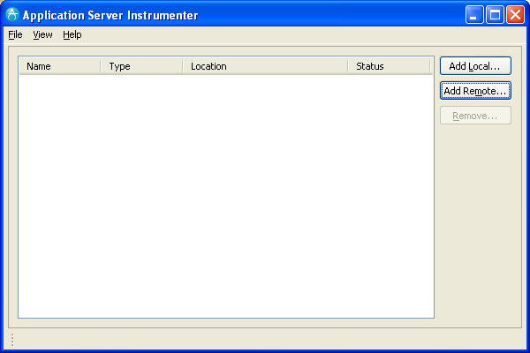
Application Server Instrumenter (ASI)

Slide 11
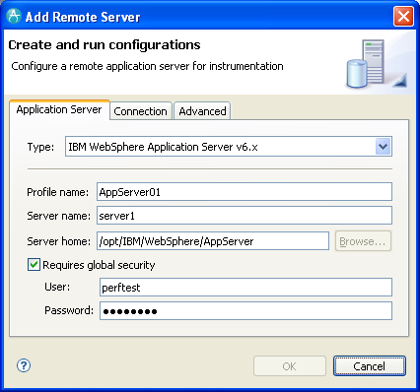
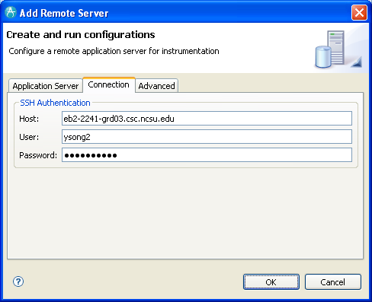
Application Server Instrumenter (ASI)

Slide 12
Application Server Instrumenter (ASI)
Application Server Tab
Type: IBM WebSphere Application Server v6.x
Profile name: AppSrv01
Server name: eb2-2241-grd03.csc.ncsu.edu
Server home: /opt/IBM/WebSphere/AppServer
User: perftest
Password: perftest
Connection Tab
Host: eb2-2241-grd03.csc.ncsu.edu or ldap.ncsu.edu (?)
User: ysong2
Password: <?>

Slide 13
Three Important Configuration Files
{WAS_PROFILE_HOME}/config/cells/{cell_name}/nodes/{node_name}/servers/{server_name}
/opt/IBM/WebSphere/AppServer/profiles/AppSrv01/config/cells/eb2-2241-grd03Node01Cell/nodes/eb2-2241-grd03Node01/servers/server1/server.xml
/opt/IBM/WebSphere/AppServer/profiles/AppSrv01/config/cells/eb2-2241-grd03Node01Cell/nodes/eb2-2241-grd03Node01/servers/server1/variables.xml
{WAS_PROFILE_HOME}/config/cells/{cell_name}
/opt/IBM/WebSphere/AppServer/profiles/AppSrv01/config/cells/eb2-2241-grd03Node01Cell/pmirm.xml

Slide 14
…
/opt/IBM/SDP/DCI/rpa_prod/tivoli_comp/app/instrument/6.103.0000/appServers/server1_101/config

Slide 15
Profile Configuration on RPT

Slide 16
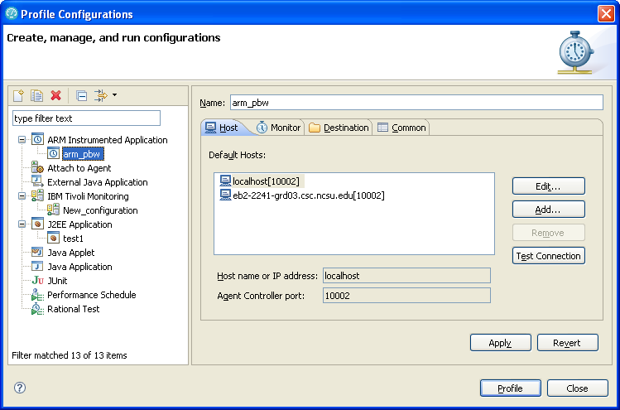
Profile Configurations

Slide 17
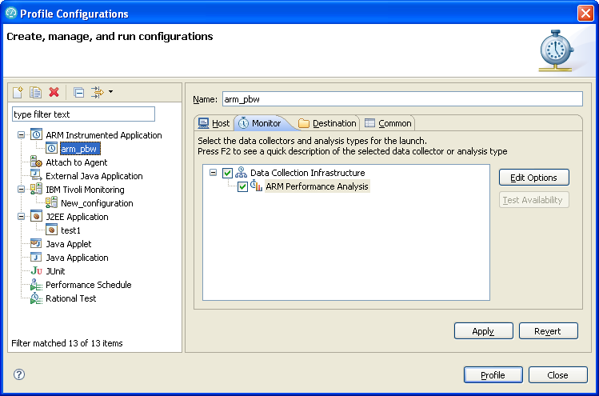
Profile Configurations (Cont’d)

Slide 18
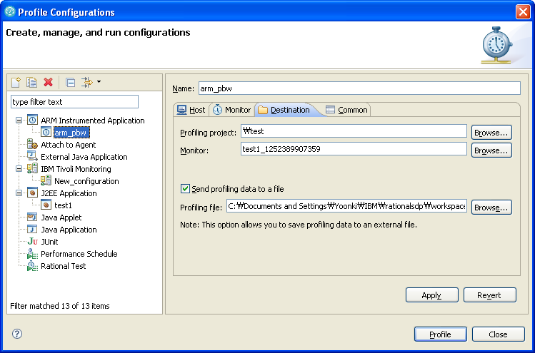
Profile Configurations (Cont’d)

Slide 19
Trouble Shooting

Slide 20
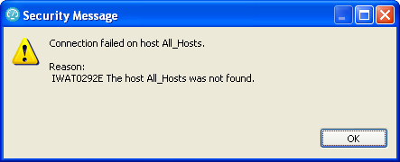
IWAT0292E
http://www.ibm.com/developerworks/forums/message.jspa?messageID=13938063

Slide 21
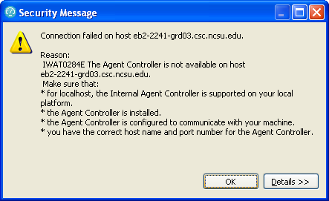
IWAT0284E
IWAT0284E

Slide 22
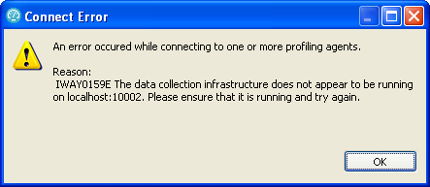
IWAY0159E

Slide 23
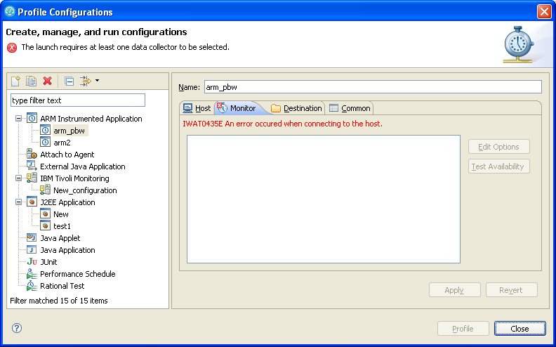
IWAT0435E

Slide 24
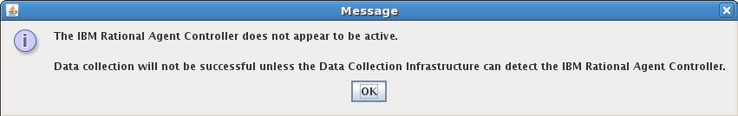
Trouble Shooting

Slide 25
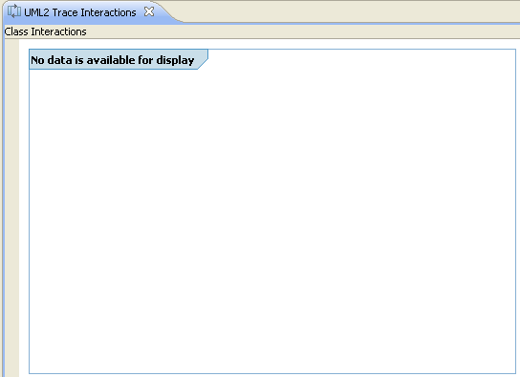
No data available for display
No data available for display

Slide 26
Hang “Connecting to the JVMPI agent”
My guess is that JVMTI (1.6) cannot deal with multi-threaded applications

Slide 27
References
Install WebSphere Application Server V6.0 for Linux on POWER (http://www.ibm.com/developerworks/systems/library/es-webapp/index.html)
WebSphere Application Server 6.1 Headless Install (http://bishop.camp.clarkson.edu/wiki/en/WebSphere_Application_Server_6.1_Headless_Install)

Slide 28
References
Using IBM Rational Performance Tester: Application Monitoring Part 1, Configuring your environment (http://www.ibm.com/developerworks/rational/library/07/0515_patel/index.html)
Using IBM Rational Performance Tester: Application Monitoring Part 2, Enabling real-time monitoring (http://www.ibm.com/developerworks/rational/library/07/0515_patel2/index.html)
Using IBM Rational Performance Tester: Application monitoring, Part 3: Importing data from IBM Tivoli database products (http://www.ibm.com/developerworks/rational/library/07/0605_patel/index.html)

